Slide 1


Sustainability
MGMT-3105 – Sustainability and Business Practices

Slide 2
MGMT-3105 – Sustainability and Business Practices
What is Sustainability?
Sustainability is defined by the EPA as:
“meeting the needs of the present without compromising the ability of future generations to meet their own needs.”
http://www.epa.gov/Sustainability/
It stems from a concept developed by Thomas Jefferson which basically means not leaving a debt for future generations.

Slide 3
MGMT-3105 – Sustainability and Business Practices
Sustainable design is the philosophy of designing physical objects, the built environment, and services to comply with the principles of social, economic and ecological sustainability.
The intention is to "eliminate [aim to minimize] negative environmental impact through skillful, sensitive design”
Sustainable design must create projects that are meaningful innovations that can shift [social] behaviour.
A dynamic balance between economy and society, intended to generate long-term relationships between user and object/service
To be respectful and mindful of the environmental and social differences
https://en.wikipedia.org/wiki/Sustainable_design

Slide 4
MGMT-3105 – Sustainability and Business Practices
Sustainable design principles…
Low-impact materials: non-toxic sustainably produced or recycled materials that require less energy to process
Energy efficiency: ideally use manufacturing processes and produce products which require less energy
“Emotionally durable design” reducing consumption and waste of resources by increasing the durability of relationships between people and products, through design – build things that last and that consumers want to own for a long time!
“Design for reuse and recycling” Products, processes, and systems should be designed for performance in a commercial 'afterlife – balancing act! Don’t compromise performance and service life in the process.
https://en.wikipedia.org/wiki/Sustainable_design

Slide 5
MGMT-3105 – Sustainability and Business Practices
Sustainability
There are four basic points to the sustainability platform:
Recycling.
Biodegradable polymers or polymers made from sustainable sources.
Reduction of the amount of material used in products.
Designing for recyclability.

Slide 6
MGMT-3105 – Sustainability and Business Practices
Recycling Codes
There are 7 primary recycling symbols.
The most commonly recycled materials are PET (Polyester), polyethylene, and polypropylene.
Polyester is commonly recycled into carpeting and polyethylene bags are recycled into more bags.
Many times polyethylene and polypropylene recycled materials are mixed and molded into items like flower pots or plastic lumber.

Slide 7
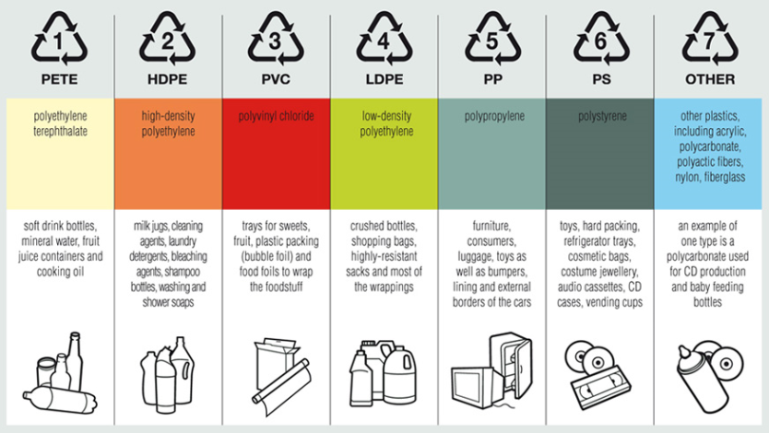
MGMT-3105 – Sustainability and Business Practices
Recycling Codes

Slide 8
MGMT-3105 – Sustainability and Business Practices
Recycling
There are two basic types of recycled plastic:
Post-consumer
Post-industrial
Post-consumer is more difficult to deal with. It needs to be sorted, washed, ground, and sometimes re-extruded into pellets. It can contain materials like metal, labels, and biological material.
Post-industrial is usually just regrind or contaminated material which is no longer useable by the original purchaser.

Slide 9
MGMT-3105 – Sustainability and Business Practices
Biodegradable
Many years ago, there were two primary plastic initiatives meant to deal with the accumulation of plastic waste; These were recycling and biodegradability.
The two initiatives were directly opposed to each other because when you make an article out of recycled material, you may want it to last for a long time, like plastic lumber.
If biodegradable materials are mixed in with the materials being recycled, it very well may cause a premature failure of the product.

Slide 10
MGMT-3105 – Sustainability and Business Practices
Biodegradable
At the time, the direction the industry chose was recycling.
Now, with the cost of oil rising, and the high demand for fossil fuels, biopolymers are rising to the forefront of the industry once again.
It’s not a hoax that we will eventually run out of fossil fuels, it’s a fact.
Our society may condemn plastics for the pollution it causes, but try to imagine life without them.
(Think convenience, safety, and durability)

Slide 11
MGMT-3105 – Sustainability and Business Practices
Biodegradable
Some of the first plastic materials created were from agricultural sources – rubbers, cellulosic.
Today, many of the newer polymers that are being developed are being created from starches. Mainly corn and potato.
Polylactic acid is produced from corn starch and has many properties similar to that of Polyester Terephthalate. It is more difficult to process and is more easily degraded by higher temperatures, but the material shows potential.

Slide 12
MGMT-3105 – Sustainability and Business Practices
Biodegradable
Why do they take so long to break down?
Typically the degradation process is performed by microbes, in the presence of oxygen and moisture. The microbes eat the starches and cause the polymer matrix to break into smaller and smaller pieces.
In a landfill, both can be scarce. Nothing degrades well in a landfill. You can dig up newspapers decades old and still read the newsprint.

Slide 13
MGMT-3105 – Sustainability and Business Practices
Material Reduction
Reducing the amount of plastic material that goes into a product (design stage) serves several purposes;
The product will cost less
There will be less material after use for recycling or disposal
There will be more material available for other uses.
Less energy is required to produce and transport the product.
If you go into product design, you must be conscious of the advantages or using less material in your products.
The improvement in material properties, processes, and designs makes the ability to reduce material content possible.

Slide 14
MGMT-3105 – Sustainability and Business Practices
Designing for Recyclability
This is an area where a plastics engineer can make a real impact if they know what they are doing.
Try to make the assembly out of a single material or compatible materials.
Make assemblies that can be easily disassembled.
Avoid screws and metal fasteners in favor of snap or press fits if possible.
Reduce the number of components.
Avoid labels if possible.
Try not to mix in thermosetting components in assemblies (thermoplastic elastomers instead of rubber seals)

Slide 15
MGMT-3105 – Sustainability and Business Practices
Designing for Recyclability
You may not have the final word on the designs you produce, but you will at least be able to offer alternatives to make your product ‘greener’ and easier to take to its next use.
It used to be that products were designed for ‘end of life’. They were designed to last for a specified period of time and that was all the thought that was given to them.
Now many products are being designed with ‘next life’ in mind. What will it be able to be used for AFTER its intended use.

Slide 16
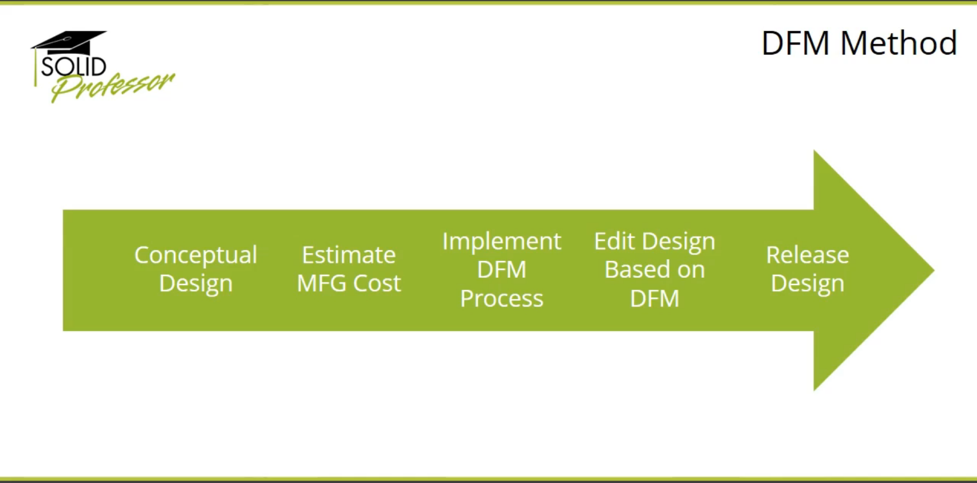
MGMT-3105 – Sustainability and Business Practices

Slide 17
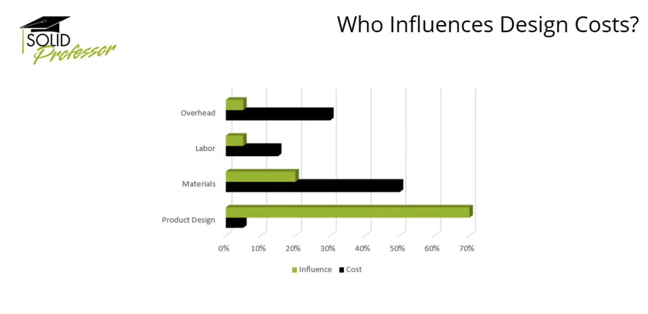
MGMT-3105 – Sustainability and Business Practices

Slide 18
MGMT-3105 – Sustainability and Business Practices
Sustainable design…the consumer’s perspective
Often, environmentally conscious consumers are willing to pay “marginally” more money and willing to accept “marginally” inferior products (usually, fit, finish, possibly material selection) if the product is more environmentally friendly.
I’m doing my part to save the planet and I’m willing to live with a product that isn’t perfectly shiny and contains recycled materials!

Slide 19
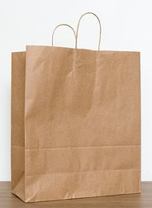
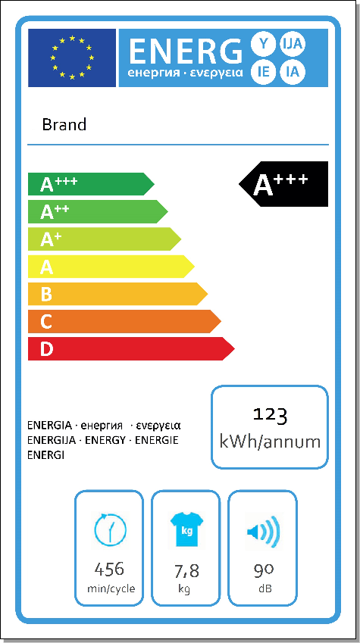
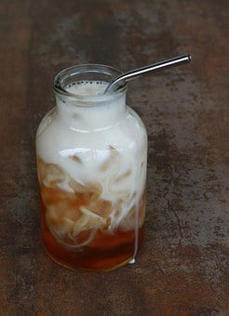
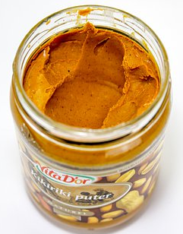
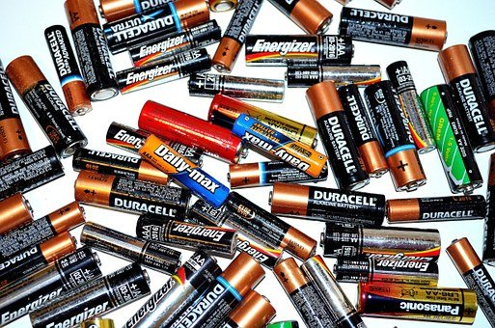
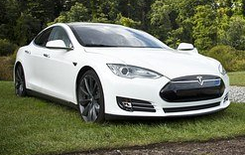
MGMT-3105 – Sustainability and Business Practices
Sustainable design…the consumer’s perspective

Slide 20
MGMT-3105 – Sustainability and Business Practices
Sustainable design…the consumer’s perspective
However, performance/functionality cannot be negatively impacted.
Consumers have a ZERO tolerance for trade off here!
They still need the product to work as well as lesser sustainably designed products because they bought that product to serve a function or address a need!
Sure, I want to save the planet but it still has to work!

Slide 21
MGMT-3105 – Sustainability and Business Practices
Sustainable design…the consumer’s perspective
And it has to last as long as other products.
Consumers have a ZERO tolerance for trade off here too!
If the design of a product is such that it becomes less robust and has a shorter service life to achieve a sustainable design, it will wear out and/or have to be replaced/serviced sooner.
Remember, this too will consume resources…
Sort of defeats the purpose doesn’t it?

Slide 22
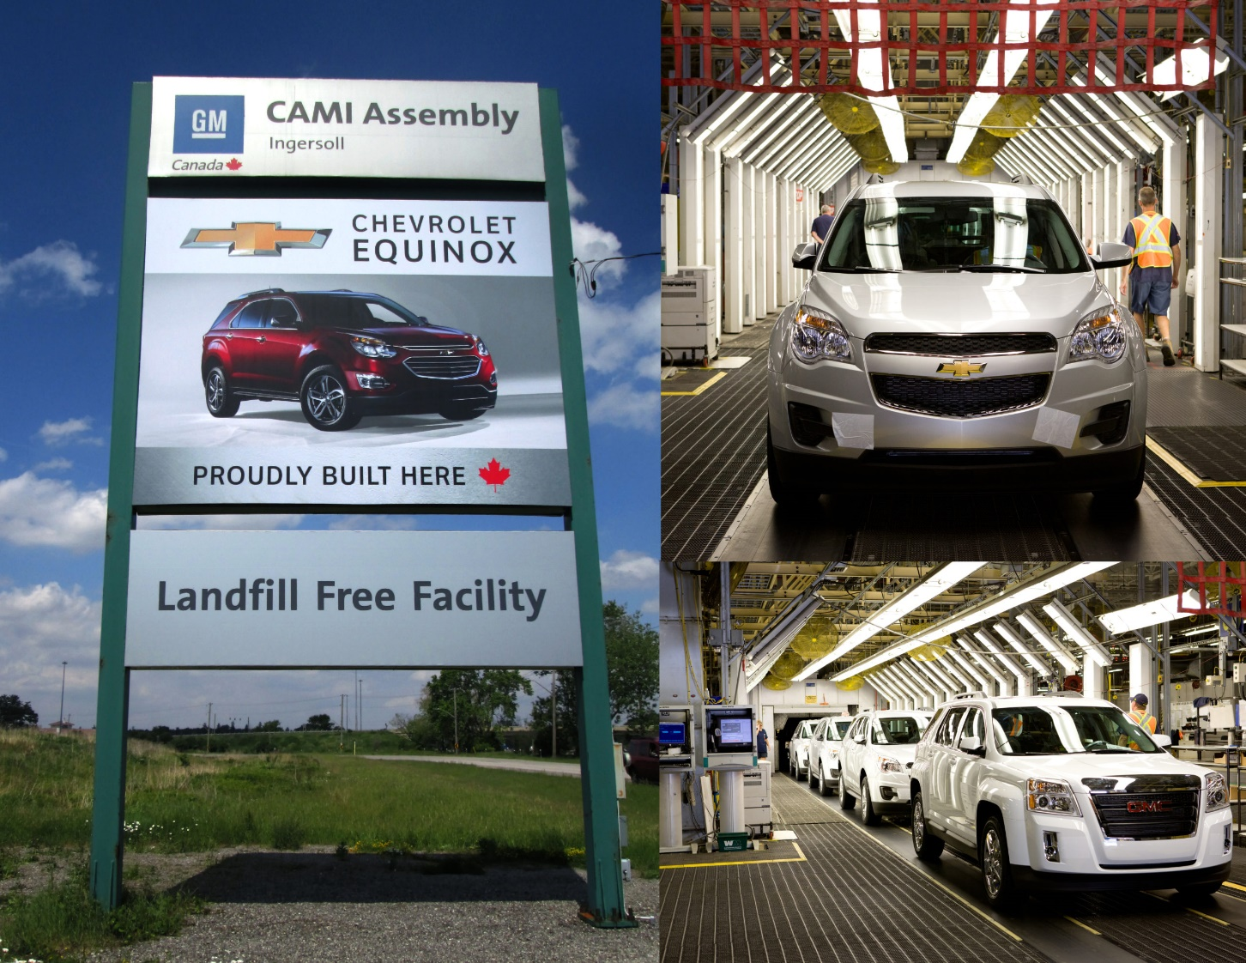
MGMT-3105 – Sustainability and Business Practices
GM CAMI Assembly in Ingersoll, ON is landfill free!
They recycle, reuse or convert to energy all waste from daily operations

Slide 23
MGMT-3105 – Sustainability and Business Practices
Sustainability in Project Management
Choose eco-friendly and ethical suppliers.
Include sustainability clauses in contracts.
Perform Environmental & Social Impact Assessment
Minimize raw material use; prioritize recyclable/renewable/local resources.
Design for energy and water efficiency.
Apply circular economy principles (reuse, refurbish, recycle).
Plan for product/service lifecycle (reuse or disposal after project end).
Reduce carbon emissions from transport and operations.
Use digital tools to cut down paper and travel.
Implement waste management (segregation, recycling, safe disposal).
Safeguard health, safety, and well-being of team and community.
Support social responsibility (local hiring, fair wages, training).
Track sustainability KPIs (carbon footprint, waste reduction %, energy saved).
Monitor suppliers/contractors for sustainability compliance.
Identify and mitigate environmental/social risks.
Conduct sustainability audits when needed.

Slide 24
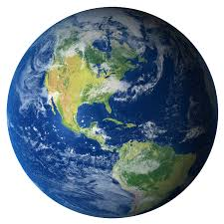
MGMT-3105 – Sustainability and Business Practices
Sustainable design…the global perspective
I think that we can all agree that this planet has a finite supply of non-renewable resources.
Let’s use these resources wisely to design products that have a longer service life and return a greater value to the consumer all while having less impact on the environment.
Remember, our children will inherit the planet from us!

Slide 25
MGMT-3105 – Sustainability and Business Practices
Discussion
Sustainable design requires that our products last as long as possible.
but
Business decisions may impede the efforts of the designer to ensure continued sales. This is referred to as “planned obsolescence”
Which one would you prefer?

Slide 26

MGMT-3105 – Sustainability and Business Practices
Questions?

